Slide 1
Introduction to VxWorks

Slide 2
What is VxWorks?
A real-time operating system (RTOS) developed as proprietary software by Wind River Systems
VxWorks is designed for use in embedded systems requiring real-time, deterministic performance, safety and security certification.
Used in industries, such as aerospace and defence, medical devices, industrial equipment, robotics, energy, transportation, network infrastructure, automotive, and consumer electronics.

Slide 3
History
VxWorks started in the late 1980s as a set of enhancements to a simple RTOS called VRTX. VxWorks key milestones are:
1980s: VxWorks adds support for 32-bit processors.
1990s: VxWorks 5 becomes the first RTOS with a networking stack.
2000s: VxWorks 6 supports SMP and adds derivative industry-specific platforms.
2010s: VxWorks adds support for 64-bit processing and introduces VxWorks 7 for IoT in 2016.
2020s: VxWorks continues to update and add support, including power the Mars 2020 lander.

Slide 4
Platform Overview
VxWorks supports Intel architecture, Power architecture, and ARM architectures.
The RTOS can be used in multi-core asymmetric multiprocessing (AMP), symmetric multiprocessing (SMP), and mixed modes and multi-OS (via Type 1 hypervisor) designs on 32- and 64-bit processors.
The platform is a modular, vendor-neutral, open system that supports a range of third-party software and hardware.

Slide 5
Features
A list of some of the features of the OS are:
Multitasking kernel with preemptive and round-robin scheduling and fast interrupt response
SMP, AMP and mixed mode multiprocessing support
Error handling framework
Bluetooth, USB, CAN protocols, Firewire IEEE 1394, BLE, L2CAP, Continua stack, health device profile
Binary, counting, and mutual exclusion semaphores with priority inheritance
Local and distributed message queues
Dual-mode IPv6 networking stack with IPv6 Ready Logo certification

Slide 6
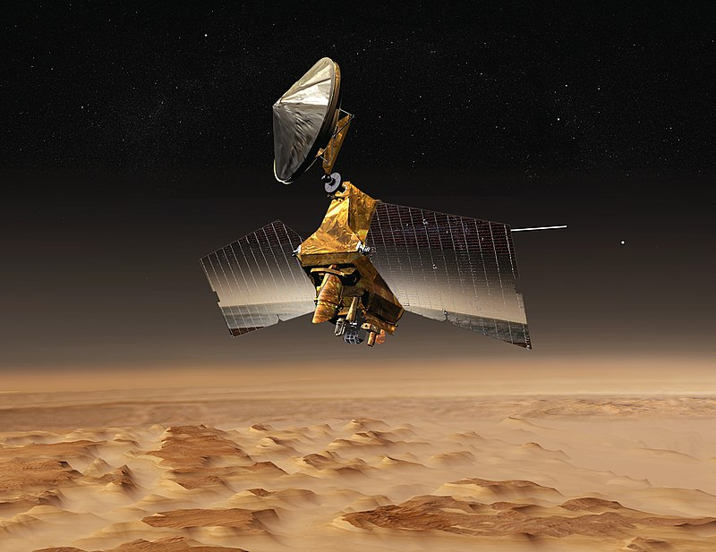
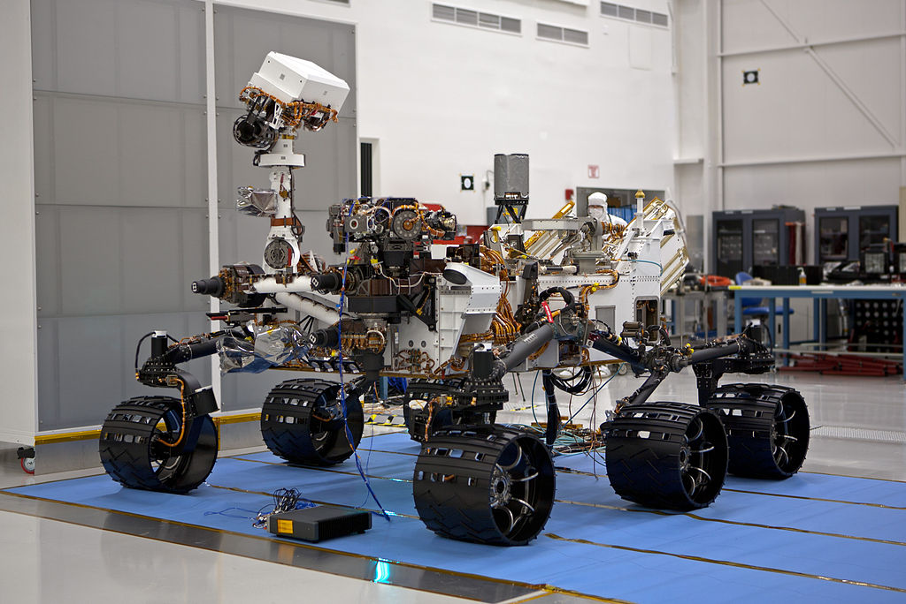
Notable Uses
Mars Science Laboratory
Curiosity rover
Mars Reconnaissance Orbiter

Slide 7
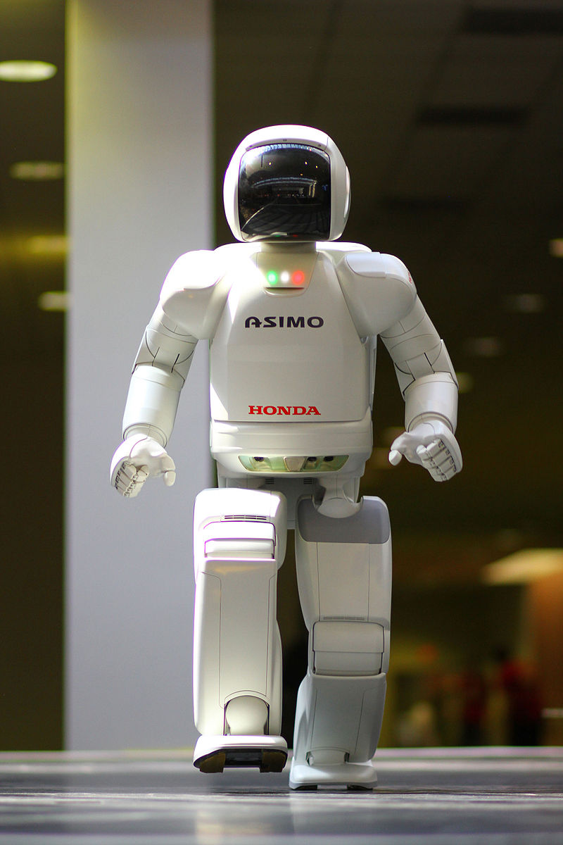
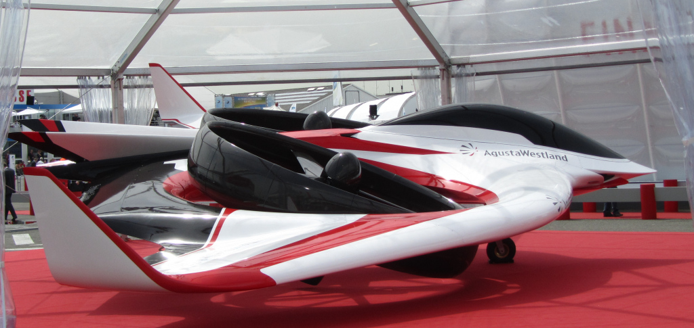
Notable Uses
Mars Science Laboratory
Curiosity rover
Mars Reconnaissance Orbiter

